Slide 1
Machine learning overview

Slide 2
Overview
we describe here the general ideas and methods used in machine learning, at a high level
we will go over all of these topics later, in much more detail
don’t worry if some of this seems abstract at this point, or there are terms you don’t know yet

Slide 3
Artificial intelligence approaches
we would like computers to perform complicated tasks, e.g., medical diagnosis
distinguish two approaches
knowledge-based: a computer program whose logic encodes a large number of properties of the world, usually developed by a team of experts over many years
machine learning: extract information directly from historical data and extrapolate to make predictions

Slide 4
Machine learning tasks
generic tasks:
build a model from some data
choose how to map raw data to feature vectors
choose a model form
choose parameter values in the model
test or validate the model
evaluate the model on unseen data to assess its performance

Slide 5
Machine learning model taxonomy: supervised vs. unsupervised
supervised learning models predict something, given some other things
called a prediction model
called regression when we predict a real scalar or vector value
called classification when we predict a value from a finite set such as
True; False
called forecasting when you predict a future value, given current and past values
unsupervised learning models just create a model of the data
called a data model

Slide 6
Machine learning model taxonomy: point vs. probability
a point estimate predicts a single value
a probability estimate predicts a distribution of values

Slide 7
Examples
what kind of models would each of these tasks use?
predict tomorrow’s rainfall, given the date and the last 10 days of rainfall data
determine from a photo of a face if the user is who she claims to be
estimate the probability of 10 possible diagnoses, given some patient data, test results
cluster customers into 22 different groups with similar buying habits
build an anomaly detector, that rates how suspicious some new data is

Slide 8
Performance metrics
we judge performance of a model on some data using a metric such as
mean-square or RMS prediction error (for regression)
error rate (for classification)
log likelihood (for probabilistic models)
examples:
our predictor predicts tomorrow’s maximum temperature with an RMS error of 1:3 C
our classifier predicts the topic of a newspaper article (from a set of 50 choices) with an error rate of 5%

Slide 9
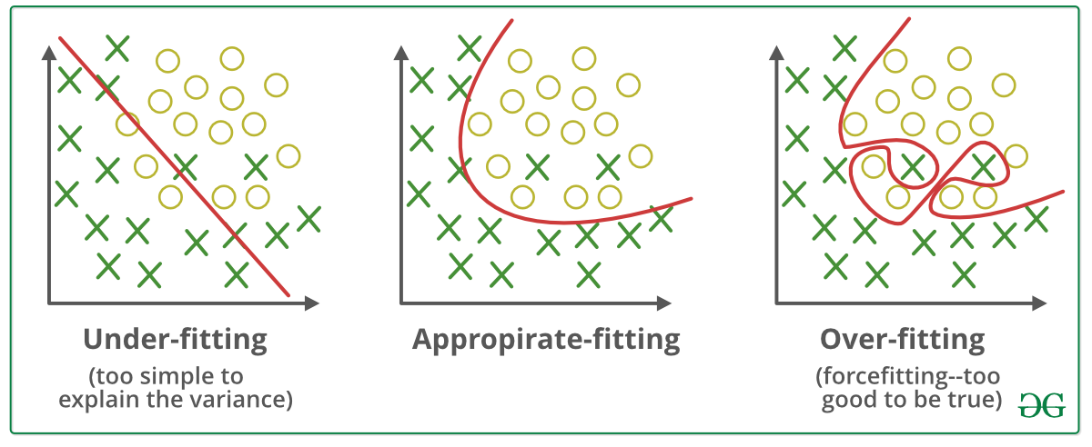
Overfitting and Underfitting

Slide 10
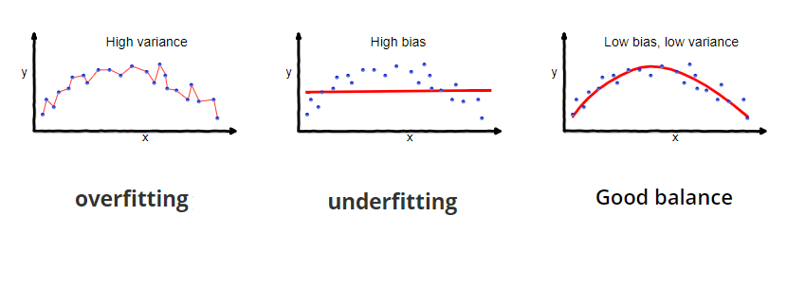
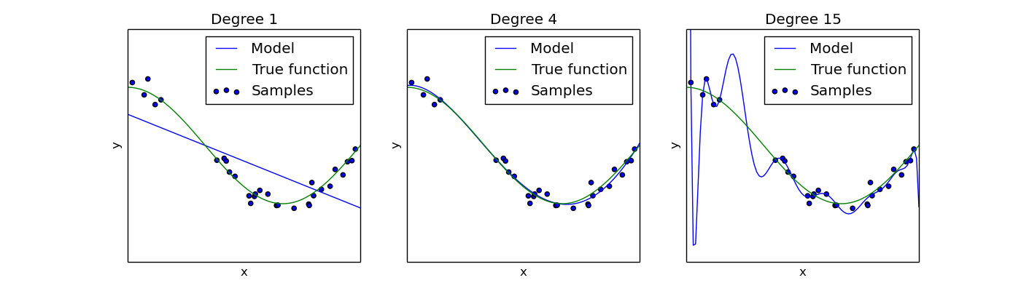
Overfitting vs underfitting
Overfitting – fitting the training data too precisely - usually leads to poor results on new data
Underfitting – model does not fit training data well
Underfitting
Overfitting
Notes:
Bias is the difference between the av
Variance is the amount that the estimate of the target function will change if different training data was used.erage prediction of model and the correct value which we are trying to predict.

Slide 11
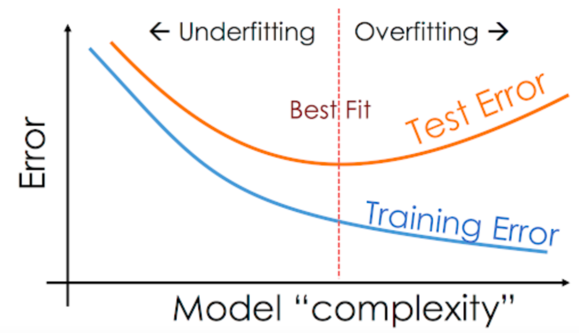
Overfitting and Underfitting

Slide 12
Learning a model
a common method of choosing a model:
choose the model structure or form or type
the model contains a number of model parameters
choose a loss function that rates how badly the model performs on a single data point or example
choose the parameter value by minimizing an average loss over the training data

Slide 13
Model Evaluation Step 1: Split data into train and test sets
THE PAST
Results Known
0
Training set
3
2
5
Data
1
Testing set

Slide 14
Model Evaluation Step 2: Build a model on a training set
THE PAST
Results Known
0
Training set
3
2
5
Data
1
Model Builder
Testing set

Slide 15
Model Evaluation Step 3: Evaluate on test set
Results Known
0
Training set
3
2
5
Data
1
Model Builder
Evaluate
Predictions
3
4
1
2
Y
N
Testing set

Slide 16
A note on parameter tuning
It is important that the test data is not used in any way to build the model
Some learning schemes operate in two stages:
Stage 1: builds the basic structure
Stage 2: optimizes parameter settings
The test data can’t be used for parameter tuning!
Proper procedure uses three sets: training data, validation data, and test data
Validation data is used to optimize parameters

Slide 17
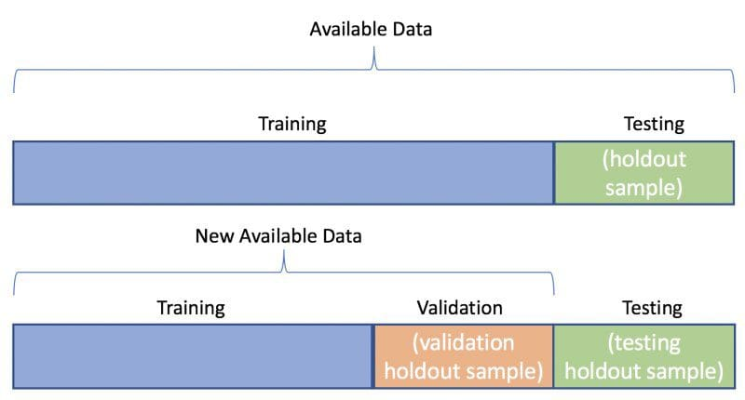
Training and validation

Slide 18
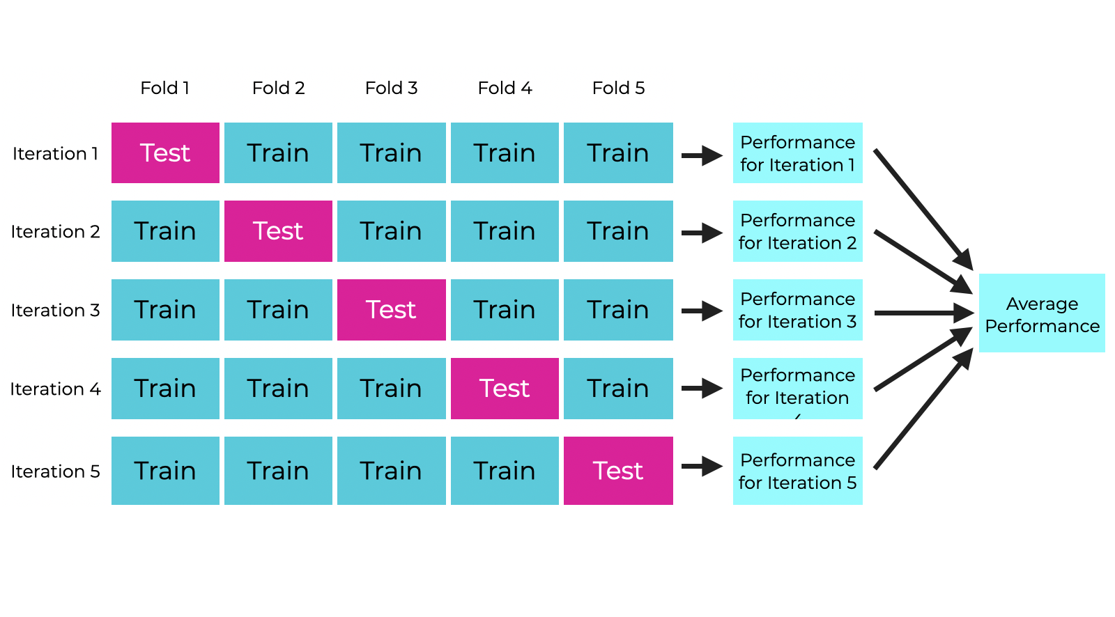
Training and validation
K-Fold Cross-Validation

Slide 19
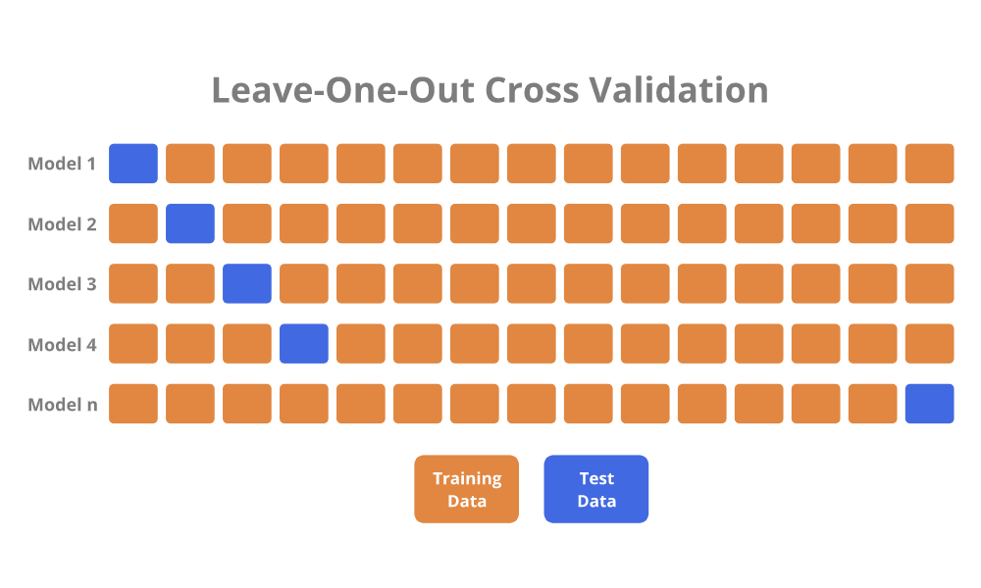
Training and validation

Slide 20
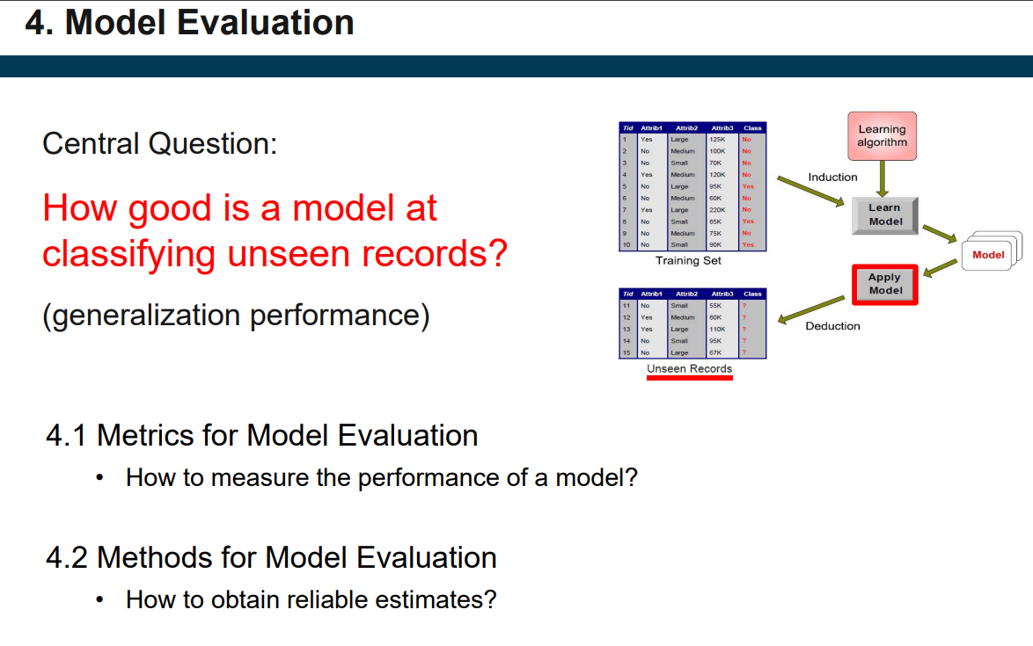

Slide 21
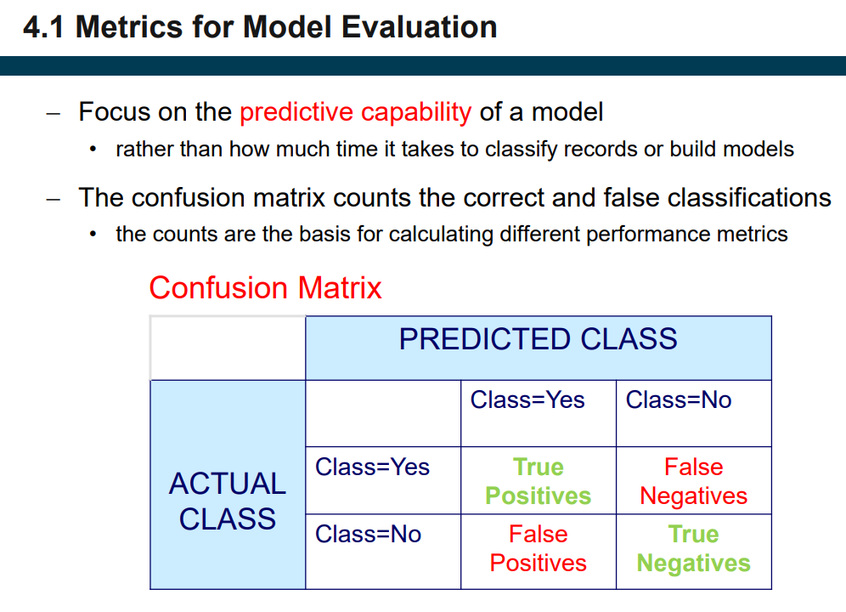

Slide 22
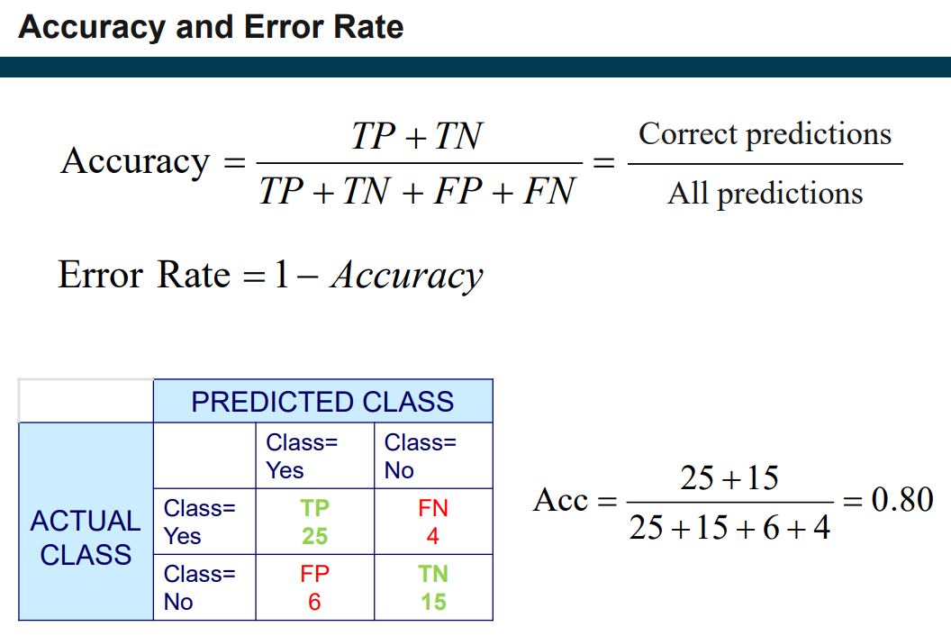

Slide 23
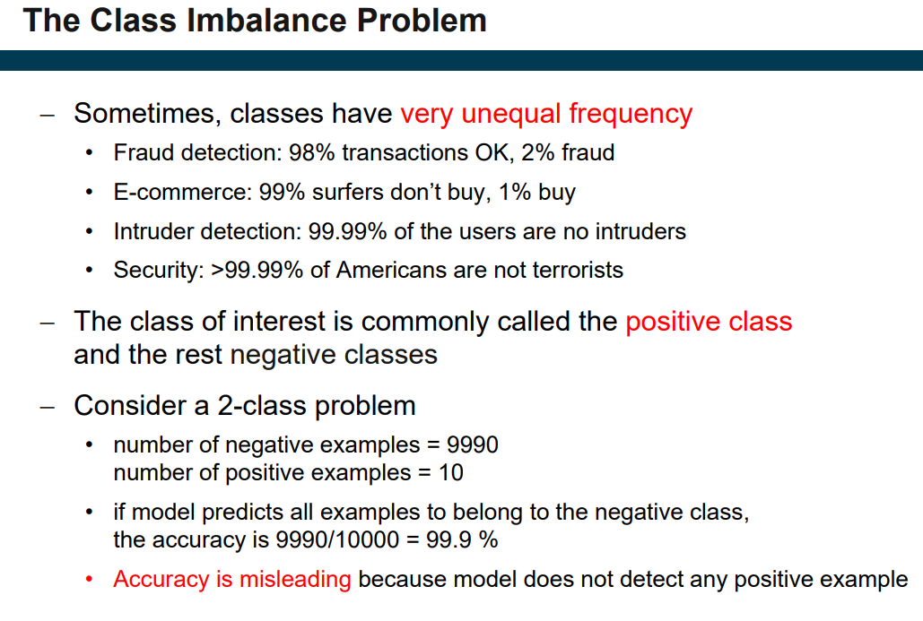

Slide 24
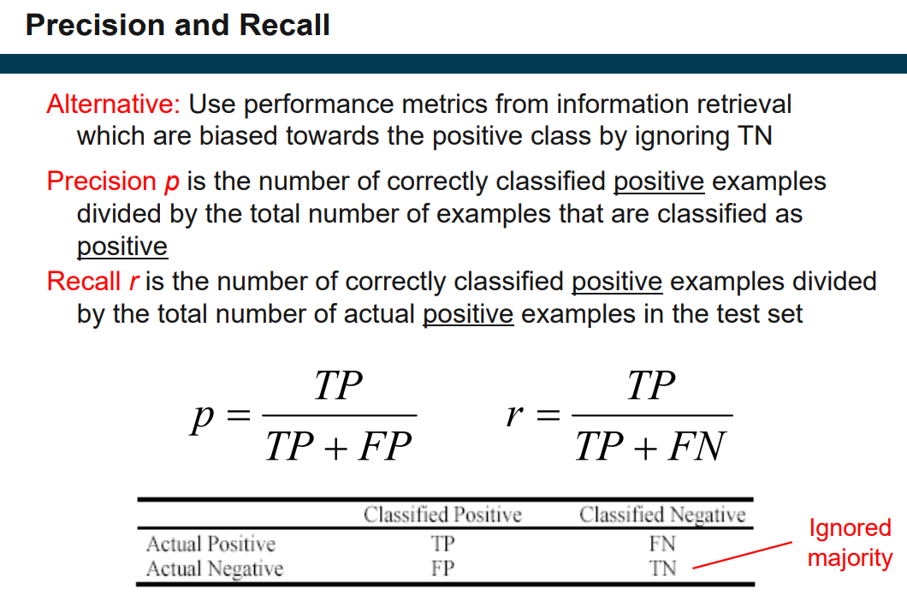

Slide 25
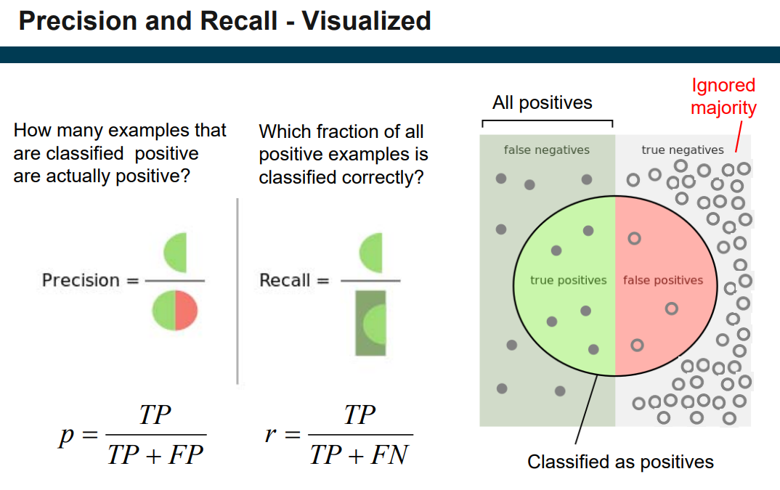

Slide 26
Use Precision when:
False positives are more important to avoid.
Spam Email detection
You don’t want to incorrectly mark a legitimate email as spam (false positive).
Use Recall when:
False negatives are more important to avoid.
Cancer detection
Missing a cancer case (false negative) is worse than incorrectly flagging someone who doesn't have it.

Slide 27
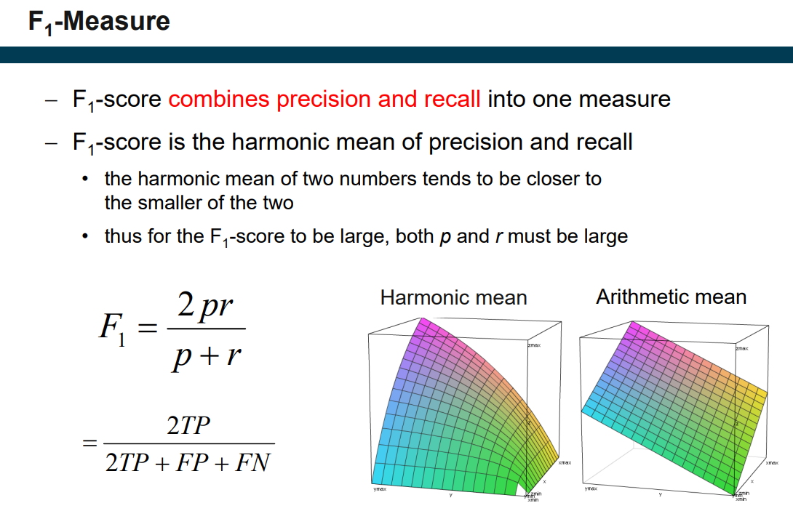

Slide 28
